Slide 1
Advanced Analytic Products – 2019 vision
Notes:
Please copy/paste the Discover logo from the Cover layout master slide (see: View > Slide Master).

Slide 2
PLATFORM ROADMAP
2018 - 2020

Slide 3
2018 to 2020 Roadmap: Key Milestones
DRAFT
 | 2018 |  |  |  | 2019 |  |  |  | 2020
 | Q1 | Q2 | Q3 | Q4 | Q1 | Q2 | Q3 | Q4 | Q1 | Q2 | Q3 | Q4
Milestones | CECL Temporary Cloud Environment | Hadoop Archive Migrated to the Cloud | 50% TD data in Cloud Modeling Platform 1.0 (SAS) Tableau integrated with Cloud Cloud Data Catalog | Snowflake access, data load patterns ready for pilot users App migrations to Cloud can begin |  |  | Real-time data first use case | Cloud Production Account SOX Compliant Teradata Aster replacement on the Cloud |  | Cross-region (East-West) resiliency Operational data store (Teradata FDR replacement) on Cloud | TD platform refresh , reduced footprint Retire On-premise Aster appliance | Multi-cloud Analytics Retire On-premise Abinitio platform
Business Implications
Risks |  |  |  |  | TD capacity limit reached Pace of app migration risks TD capacity | Prod acct with SOX compliance dates
1
2
3
4
5
6
7
8
9
10
11
Modelling platform 2.0 on OpenShift (H20; R; Python)
Abi on Linux
External data integration
Self-service , Cloud-portal
TD capacity limit reached
Cloud Production Account
100% TD data in Cloud S3
FICO DMP Insourced
CECL analytics enabled on Cloud.
Discover data archived on Cloud-improved resiliency.
Pilot users can experiment with analytics on subset of Discover data available on Snowflake MPP on the cloud.
App migrations can begin. Need to prioritize across critical DR apps, new and existing apps.
Expanded analytic user base, external data integration to perform analytics on majority of Discover data on cloud.
Resiliency of data transformation platform (Abi) materially improved and deployed on modern operating system.
Improved Cloud user experience with a Self-service portal and enterprise container platform for Modelling.
New Cloud account with production controls available.
All of Teradata data available on the cloud
Real-time analytics capabilities available on the Cloud.
FICO DMP decisioning insourced environment available.
Cloud accounts fully production ready.
Teradata Aster (Clickstream analytics) migrated to Cloud based capability.
Cross-region Cloud DR resiliency for Tier 1 apps. FDR Replacement on the Cloud
Teradata platform due for refresh, footprint reduced.
Multi-Cloud analytics capability.
Resiliency of Gen 1 platform
TD capacity

Slide 4
DRAFT
2018 to 2020 Roadmap: Platforms
 |  | 2018 |  |  |  | 2019 |  |  |  | 2020 |  |  |  | Outcomes
 |  | Q1 | Q2 | Q3 | Q4 | Q1 | Q2 | Q3 | Q4 | Q1 | Q2 | Q3 | Q4 | Legend:
1 | Set up Cloud account for Analytics & Production deployment with proactive monitoring, automation and security |  |  |  |  |  |  |  |  |  |  |  |  | Accounts: 1) Analytics 2) Staging 3) Prod 4) SOX Automation : Infrastructure as code (IAC) Security : Universal access layer (UAL) Cloud self-service portal – 1) Platform as service. 2) Data as service. 3) Model as service Cloud Resiliency: 1) Cross-region DR 2) Multi-cloud
2 | Develop Cloud data exchange patterns for internal data, external data and Real-time data |  |  |  |  |  |  |  |  |  |  |  |  | Cloud data patterns : 1) TD, EDS to S3 Avro 2) S3 to Snowflake 3)ORC 4)External data 5)Real-time 6)Graph Universal Data Loader – Event based framework ETL paterns on the Cloud : 1) EMR-Spark ETL 2) Abi-container POC 3) Abi-container pattern deployment
3 | Cloud Data platform (Data Lake, MPP Database, Graph DB, ODS) and processing platform |  |  |  |  |  |  |  |  |  |  |  |  | Data storage : 1) S3 2) Snowflake. 3) Graph Db. 4) ODS Processing pltfrm : Openshift container platform Real time platform : Kafka Decomission On-premise HDP platform Teradata refresh
4 | Build Analytic and deployment capabilities with access to usable data |  |  |  |  |  |  |  |  |  |  |  |  | Zipline – Analytic tool : 1) SAS 2) H20 3) Spark, Python, Jupyter, Rstudio 4) New UI Model workflow integration with Jira Model deployment : Model run-time environment Model as service : Model as Rest APIs
5 | Build strong capabilities in Data management and governance tools |  |  |  |  |  |  |  |  |  |  |  |  | Data catalog tool: Alation Data quality tool: Ab Initio DQE
6 | Build capabilities for data visualization & reporting |  |  |  |  |  |  |  |  |  |  |  |  | On-prem Tableau integrated with Cloud BI stack (Tableau) native on AWS
7 | Resilient Ab Initio ETL platform and remove single points of failure in the architecture |  |  |  |  |  |  |  |  |  |  |  |  | AIX to Linux job migration GPFS to NFS migration Cloud job scheduler: 1) POC 2) Implementation Tool replacement : 1) Harmony 2) Live queue 3)B&C Abi on Cloud-container buildout ETL job migration to Cloud Abi platform Retire On-premise ETL grid
Critical Path
Risk
1
2
3
4
1a
1
1b
1c
1
2
3
1d
1
2
1e
2
1
2
3
4
5, 6
2a
2b
1
2
3
2c
3
1
2
3
4
3a
3b
3c
3d
3e
1
2
3
4
4a
4
4b
4c
4d
5
5a
5b
6
6a
6b
7a
1
2
7b
7c
7
2
3
1
7d
7e
7g
7f

Slide 5
Cloud Foundations Roadmap
2018 | 2019 | Outcomes
1
Nov | Dec | Jan-Feb | Mar-Apr | May-Jun | Jul-Aug | Sep-Oct
Critical Path
Risk
1 | Cloud accounts (Production) |  |  |  |  |  |  |  | Operationalize Staging / Pre-Prod AWS Account (Q1:19) Operationalize Prod / Deployment Account (Q2:19-Q3:19) Process Management (Engagement & Delivery) Role Based Access – Revoke Developer Access
2 | Cloud - Workload Scheduler |  |  |  |  |  |  |  | Cloud-native solution (ie. AirFlow, Chronos, Rundeck,..) High Availability / Failover / Support Operation Integration of Monitoring & Alerting solution
3 | Extend Alerting for Customization |  |  |  |  |  |  |  | Enrolling Infrastructure Alerts (Q4:18) Service Now Integration (Q1:19) Enrolling Other App/Services (Q1:19) Onboarding Intra-Departmental users (Q1:19)
4 | JIRA on AWS |  |  |  |  |  |  |  | Base install of JIRA (Q4:18) Build/Test Redundancy and Failover (Q4:18 – Q1:19) Enhance for Large Data sets and decoupled criteria (Q1;19) Install on Deployment/Prod Account (Q2:19)
5 | Self Service Portal |  |  |  |  |  |  |  | Vendor Onboard (Q2) Development & Integration (Q2-Q3) UI changes & Hand-off to Cloud Foundations (Q3-Q4)
6 | OpenShift for AAP |  |  |  |  |  |  |  | POC of Analytics Tooling (Q4:18) EDS and ZipLine Support & Integration (Q4:18 – Q1:19) Distributed H2O & Spark (Q1-Q3)
7 | CRD Scan on EBS Volumes |  |  |  |  |  |  |  | Prototype script scan of single criteria (Q4:18) POC stateless scanning Agent (Q1:19) Enhance for Large Data sets and decoupled criteria (Q2:19) Incorporate Scheduling, Monitoring, Notification (Q3:19)
8 | Innovation/Research – New Technology Introduction |  |  |  |  |  |  |  | Logging: X-Ray, CloudWatch Analytics, etc. Compute: New EC2 Types, Hibernation, Microservices, etc. Platforms: OpenShift, Lake Formation, GCP, Azure, etc. Security: KMS, Audit & Compliance, etc.
1
2
3
4
1
2
3
1
2
3
4
1
2
3
4
1
2
3
1
2
3
1
2
3
4

Slide 6
Universal Access Layer (UAL) Sprint Schedule
1
DRAFT
 |  | Sprint # |  | 18.12 | 18.13 | 18.14 | 18.15 | 18.16 | 18.17 | 18.18 | 18.19 | 18.20 | 19.1 | 19.2 | 19.3 | 19.4 | 19.5 | 19.6 |  | Outcomes
 |  | End Date |  | 9/14 | 9/28 | 10/12 | 10/26 | 11/9 | 11/23 | 12/7 | 12/21 | 1/4 | 1/18 | 2/1 | 2/15 | 3/1 | 3/15 | 3/29 |  | Legend:
1 | Redshift |  |  |  |  |  |  |  |  |  |  |  |  |  |  |  |  |  |  | R1: Analytics (Prod) Cluster IDM Integration R2: Development Cluster (CECL WS) IDM Integration R3: Development Cluster (SOT) IDM Integration R4: UAT Cluster IDM Integration
2 | Snowflake |  |  |  |  |  |  |  |  |  |  |  |  |  |  |  |  |  |  | R1: Production IDM Integration (Non-SSO) R2: Okta (SSO) Integration – R3: Create new snowflake accounts that align with Dev, modeling, deployment account strategy and integrate with UAL (estimate of 2 sprints after foundational work is done)
3 | Enterprise S3 (SOT data) – Avro / ORC |  |  |  |  |  |  |  |  |  |  |  |  |  |  |  |  |  |  | R1: UAL Metastore (DynamoDB) R2: Session Initialization Service End-to-End Prototype R3: Registration Service End-to-End R4: Enterprise Data Lake IDM Roles Created R5: Boarding and testing
4 | Governance and Reporting |  |  |  |  |  |  |  |  |  |  |  |  |  |  |  |  |  |  | Details need to be flushed out
To be Confirmed
R1(10/26)
R2(10/26)
R3 (12/7)
R4 (12/7)
Feature Complete
R1 (11/30)
Feature Complete. UAL Snowflake access provisioning (non-SSO)
R2 (Q1 2019)
R3 (Q1 2019)
Feature Complete
R1(10/26)
R2 (12/7)
R3 (12/14)
R4(12/21)
R5 (12/30)
Feature Complete
(S3 – Fine grain access)

Slide 7
Cloud Data Products Sprint Schedule
2
DRAFT
 |  | Sprint # |  | 18.12 | 18.13 | 18.14 | 18.15 | 18.16 | 18.17 | 18.18 | 18.19 | 18.20 | 19.1 | 19.2 | 19.3 | 19.4 | 19.5 | 19.6 |  | Outcomes
 |  | End Date |  | 9/14 | 9/28 | 10/12 | 10/26 | 11/9 | 11/23 | 12/7 | 12/21 | 1/4 | 1/18 | 2/1 | 2/15 | 3/1 | 3/15 | 3/29 |  | Legend:
1 | Universal Data Loader (Snowflake) |  |  |  |  |  |  |  |  |  |  |  |  |  |  |  |  |  |  | R1: Pattern to load backfill AVRO files to Snowflake R2: Pattern for insert only delta loads to Snowflake R3: Upsert & Delete delta loads to Snowflake R4: AVRO to ORC w/ Glue Integration R5: Web UI
2 | Hadoop to AVRO on S3 |  |  |  |  |  |  |  |  |  |  |  |  |  |  |  |  |  |  | R1: Ability to convert Hive data to AVRO & move to Data Lake R2: Minor Enhancements, bug fixes
3 | External API to AVRO on S3 |  |  |  |  |  |  |  |  |  |  |  |  |  |  |  |  |  |  | R1: API Facebook data to AVRO on S3 w/ Generic JSON to AVRO converter R2: Allow multiple API Sources, Integration w/ AWS logging, Improvements to make more Generic R3: Google Connector
4 | Teradata & Ab Initio Load Files to AVRO on S3 |  |  |  |  |  |  |  |  |  |  |  |  |  |  |  |  |  |  | 2018.9.1 Improved Speed and AVRO Metadata 2018.9.2 Improved Redshift loading robustness 2018.10.1 Redshift params optional, bug fixes 2018.11.1 Add new sub-products, bug fixes 2018.11.2 Create delete Avro files & delete to RedSh 2018.11.3 Date of data as partition, ability to replace partition, bug fixes 2018.12.1 Security Enhancements, bug fixes
5 | Data Validation Tools |  |  |  |  |  |  |  |  |  |  |  |  |  |  |  |  |  |  | 3.0.0 Speed Increase, Count only & data filter options 3.1.0 Ability to specify data range to validate 3.1.1 Ability to email out validation report 3.1.4 Minor Enhancements 3.4.3 Add Deep AVRO validation, bug fixes 3.5: Speed & Minor Enhancements, nug fixes 3.6: Delete Validation in AVRO now possible 4.0: Ability to validate Snowflake, Delete validation improvements, support date of data as partition, AVRO speed increase, bug fixes
6 | Real-time Event Bus to Data Lake |  |  |  |  |  |  |  |  |  |  |  |  |  |  |  |  |  |  | R1: Subscribe to Event bus v2 & store data as AVRO Data Lake.
To be Confirmed
R1(11/19)
R2 (12/12)
R3 (12/27)
R4 (2/15)
R5(3/29)
R1 (11/23)
R2 (12/21)
Feature Complete
R1 (12/7)
R2 (1/18)
R3
11/1
R2018.11.1 ✓
10/22
11/6
R2018.11.2 ✓
9/6
R2018.9.1✓
R2018.10.1✓
R2018.11.3 (11/23)
9/14
R2018.9.2✓
R2018.12.1 (12/21)
Feature Complete
9/13
3.0✓
9/17
3.1✓
9/18
3.1.1✓
9/26
3.1.4✓
3.4.3✓
10/17
3.5✓
10/21
11/7
3.6✓
4.0 (11/19)
Feature Complete
R1

Slide 8
ZIPLINE Product Sprint Schedule
4
Analytics Workbench(ZIPLINE)
2018 | 2019 | Outcomes
Nov | Dec | Jan | Feb | Mar | April | May | June | Jul
Critical Path
Risk
1 | Analytics tools provisioning (Model Development) |  |  |  |  |  |  |  |  |  | 1. SAS on OpenShift Test cluster 2. SAS on D&D OpenShift cluster with LDAP 3. Jupyter notebook /H2O flow on D&D OpenShift cluster with LDAP 4. Data sharing between users on OpenShift cluster. 5. Onboarding up to 10~50 users 6. Onboarding up to 100~300 users (Dependency on size of OpenShift cluster 7. GitHub integration (Model code repository) 8. Automated OpenShift cluster management (pod scaling from UI) 9.UX-UI redesign/development
2 | Data provisioning capabilities |  |  |  |  |  |  |  |  |  | 1a.Data discovery on snowflake (data dictionary of snowflake) 1b.Data provision on snowflake 2. Alation catalog integration with zipline 3. Integration with OKTA
3 | Model Workflow (JIRA) integration and collaboration |  |  |  |  |  |  |  |  |  | 1.Zipline integration with JIRA 2.Project Admin access to add/remove members to/from project 3.UI changes 4. Streamline notification process
4 | Zipline 2.0 (New web portal) |  |  |  |  |  |  |  |  |  | 1.Zipline AAP portal 2.Integration with Platform services (Self service , Alation, UAL)
5 | Model Deployment and Execution |  |  |  |  |  |  |  |  |  | 1.Requirement gathering /tool evaluation for deployment (Axiom, Catalina) Model Code conversion to executable Jar Extract Model Data prep steps to a transformation pipeline Model code execution in container (docker file development/deployment as docker container) Central Change control repository for model deployment for UAT/PROD environment Jenkins pipeline to get changes and deploy containers in OpenShift Scheduler process to run model on trigger or regular intervals . Blue –Green deployment pipeline
1
2
3
4
5
6
7
8
9
1a
1b
2
3
2
1
3
4
1
2
1
1a
1b
1c
1d
1e
1f
1g

Slide 9
BI Tools
6
2018 | 2019 | Outcomes
Nov | Dec | Jan | Feb | Mar | Apr | May | June | Jul | Aug | Sep | Oct | Nov | Dec
Critical Path
Risk
1 | Deploy Tableau in AWS |  |  |  |  |  |  |  |  |  |  |  |  |  |  | 1. Provision Tableau platform in AWS 2. Integrate Tableau with Snowflake 3. Performance testing and data optimization 4. Make Tableau operational
2 | Enhancement of On-Prem Tableau |  |  |  |  |  |  |  |  |  |  |  |  |  |  | Additional processing capacity enabled Utility servers provisioned TabPy enabled on on-prem Tableau Business users’ Pilot of TabPy
3 | Tableau version upgrades (on-perm/cloud) |  |  |  |  |  |  |  |  |  |  |  |  |  |  | Semi-Annual Tableau version upgrades
4 | Evaluation of Cloud Native BI Tools |  |  |  |  |  |  |  |  |  |  |  |  |  |  | Provision QuickSight and integrate with Snowflake Performance testing and data optimization
5 | Power BI Retirement |  |  |  |  |  |  |  |  |  |  |  |  |  |  | Build CRM report with Tableau and Jira Business user testing Build Finance/CCAR reports in Tableau Business user testing
7 | Cognos retirement |  |  |  |  |  |  |  |  |  |  |  |  |  |  | Remaining Cognos reports migrated to Tableau Cognos reports are retired
1
2
3
4
1
2
3
4
1
1
1
2
1
2
3
4
1
2

Slide 10
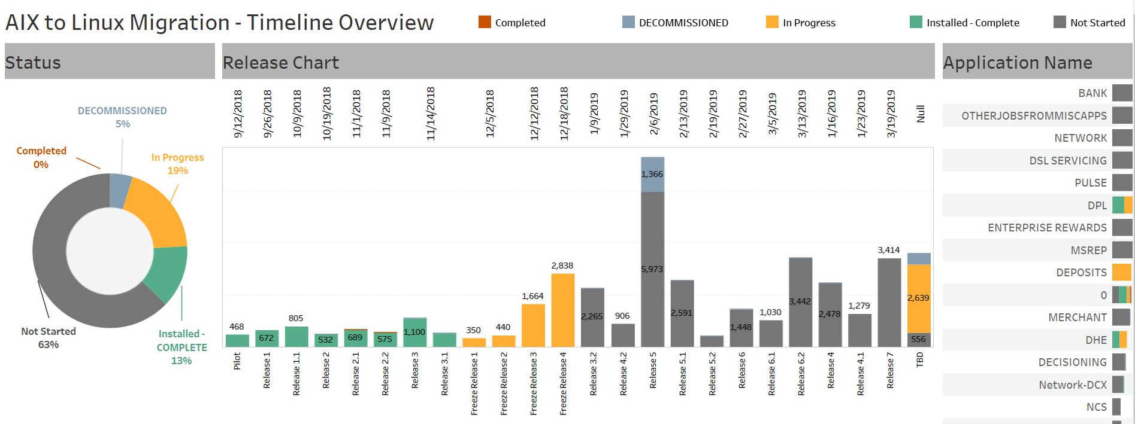
11
8
Ab Initio – AIX to Linux Migration
7
2018 | 2019 | Outcomes
Nov | Dec | Jan | Feb | Mar | April | May | June | Jul
Critical Path
Risk
1 | Ab Initio - AIX to Linux migration |  |  |  |  |  |  |  |  |  | 1. Freeze Release 3 2. Freeze Release 4 3. Release 3.2 4. Release 4 5. Release 4.1 6. Release 4.2 7. Release 5 8. Release 5.1 9. Release 5.2 10. Release 6 11. Release 6.1 12. Release 6.2 13. Release 7 14. Overflow and special circumstances releases
1
2
3
4
5
6
7
8
9
10
11
12
13
14

Slide 11
SAS
7
2018 | 2019 | Outcomes
Nov | Dec | Jan | Feb | Mar | Apr | May | June | Jul | Aug | Sep | Oct | Nov | Dec
Critical Path
Risk
1 | Deploy SAS in Containers |  |  |  |  |  |  |  |  |  |  |  |  |  |  | 1. SAS running in containers 2. SAS integrated with shared high performance storage 3. SAS integrated with Snowflake and S3 4. SAS Performance testing and data optimization
2 | Migrate data and users to SAS in the Cloud |  |  |  |  |  |  |  |  |  |  |  |  |  |  | Data migration pattern and mechanism established User provisioning enabled and IDs populated Business Unit Pilot User boarding
1
2
3
4
1
2
3
4

Slide 12
Ab Initio
7
2018 | 2019 | Outcomes
Nov | Dec | Jan | Feb | Mar | Apr | May | June | Jul | Aug | Sep | Oct | Nov | Dec
Critical Path
Risk
1 | On-Prem Ab Initio Improvements |  |  |  |  |  |  |  |  |  |  |  |  |  |  | Dev Ab Initio migrated from GPFS to NFS shared storage Prod and DR Ab Initio migrated from GPFS to NFS shared storage (faster data replication and disaster recovery) Dev, Prod, and DR Ab Initio servers migrated from virtual to physical hardware
2 | POC Cloud Ab Initio in Containers |  |  |  |  |  |  |  |  |  |  |  |  |  |  | Ab Initio co-op running in containers POC Evaluate shared high-performance storage for Ab Initio Ab Initio integrated with shared high performance storage Ab Initio connects to Snowflake and S3
3 | Optimize Ab Initio Supporting Tools (Cataloging, Code Promotion, and Data Quality) |  |  |  |  |  |  |  |  |  |  |  |  |  |  | Livequeue enabled for code promotion in the Cloud DataHub catalogs data in cloud data sources Ab Initio connects to DQE for data quality evaluation Evaluate and select cloud-based scheduling tool
4 | Cloud Ab Initio ETL ready for Production |  |  |  |  |  |  |  |  |  |  |  |  |  |  | Production ETL cluster w/ supporting tools is built Full-system integration testing Re-write sampling of production graphs and conduct UAT Cloud-based ETL platform is production-ready
5 | Maestro scheduling tool enhancement |  |  |  |  |  |  |  |  |  |  |  |  |  |  | Maestro job scheduling runs on more powerful servers Additional Maestro configuration and upgrades to enhance performance
1
2
3
1
2
3
4
1
2
3
4
1
2
3
4
1
2

Slide 13
PLATFORM ARCHITECTURE
Building Blocks of Next-Gen Analytic Capabilities

Slide 14
Discover’s strategy depends on Analytics; AAP is building foundational and strategic elements to enable Discover’s success.
FOUR STRATEGIC PILLARS
C. Platforms
Improve operational resiliency of existing platforms during transition period Deploy Gen 3 public cloud-based “Cloud Data Platform” Migrate analytics to Next Best Action (NBA) paradigm
A. People
Align AAP operating model to improve business engagement and value delivery Enhance talent and organizational effectiveness
B. Process
Improve work intake, assessment, and prioritization process Standardize software development, testing, deployment, and operational processes
D. Data
Develop new Enterprise Information Architecture Create Cloud Data Catalog across enterprise Simplify data governance and improve compliance

Slide 15
Today we are managing analytical platforms across multiple generations of technologies. We need to consolidate to reduce complexity to create value.
Gen 3: Establish Platform
Data Patterns
Security
Automation
Gen 2: Reduce footprint
Need to reduce footprint and migrate data / apps
Gen 1: Improve Resiliency
Supports over 90% of Analytic users/processes
Need to improve resiliency
Need long-term strategy/path
Gen III – Cloud
Need to migrate
> 1PB
Data
50K Apps
1500 Users
Gen II – Hadoop
Gen I - Teradata
2017
2018
2019
2020
2021
2022
Strategy
People
Process
Platforms
1
2
3
Data
Roadmap

Slide 16

Cloud Data Platform will be scalable, interoperable, and support advanced analytics needs to achieve Discover’s vision.
 |  |  |  | Card | Bank |  | Payment |  | Enterprise
AAP will deliver a Cloud Data Platform (CDP) A suite of technologies that enable the end-to-end delivery of data and insights |  |  |  | Reporting |  | Modeling |  | Decisioning
 |  |  |  | Internal and external reporting and visualization |  | Model training and deployment |  | Decisioning platform (batch & real time)
 | Discover Data |  |  | Cloud Data Assets
 |  | Cloud Data Exchange | Cloud ETL & Quality |  |  |  |  |  |  | Cloud Data Catalog
 | External Data |  |  | Customer360 (CIMS 2.0) | Marketing360 (Marketing Db) |  | Merchant360 (DCX) |  | Entity360 (AML 2.0/Fraud)
 |  |  |  | Cloud Data Lake
Strategy
People
Process
Platforms
1
2
3
Data
Roadmap

Slide 17
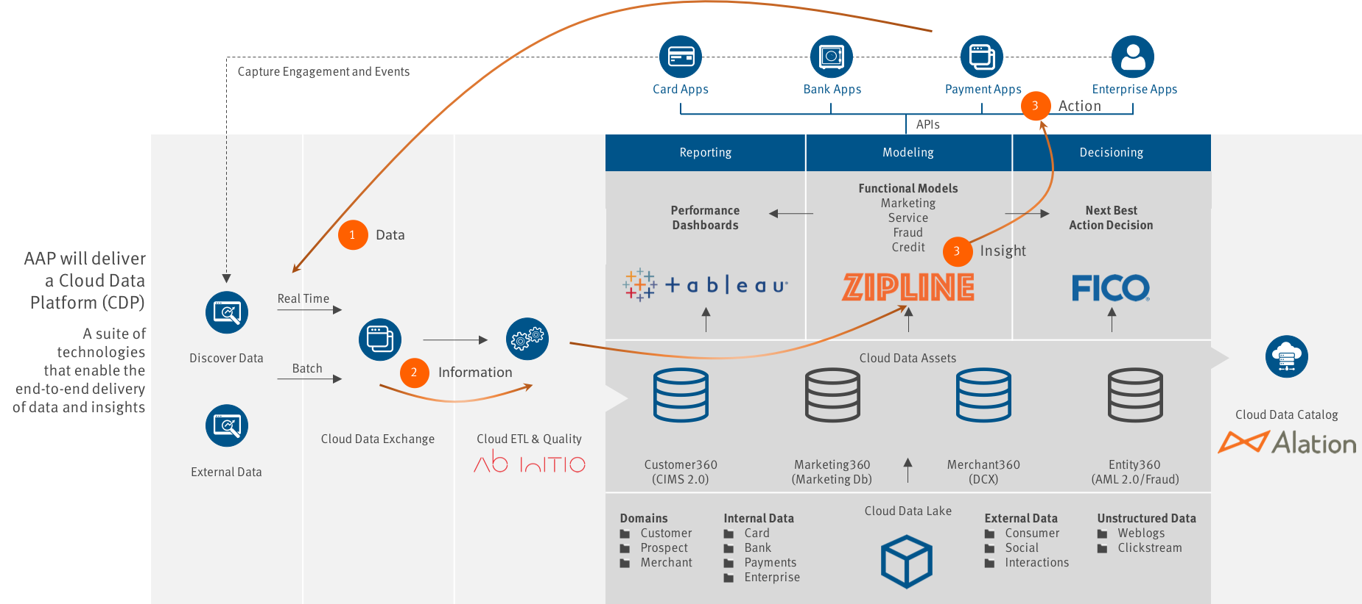
Cloud-based analytics enables us to shift to a Next Best Action (NBA) paradigm, representing a transition from functional to personalized.

Slide 18
CLOUD ACCOUNT & TOOLS

Slide 19
DRAFT
Designated Analytics Environment – Cloud Foundations Lifecycle
Goals
Analytics Development
Infra / App Innovation, Design & Development
Analytics Modeling
Data science work, model research, testing, data analyses
Analytics Deployment
Model deployment, regulatory (SoX, etc..) solutions
Business Growth
Console + IaC Deploy
IaC Deploy
Pipeline Deploy
Streamline (Self-Service)
Self-Service Portal
IaC
Release Management
Blue-Green Deployments
Data Catalog
“Lullaby”/Hibernation + Reserve Instances
“Lullaby”/Hibernation + Reserve Instances
Reserve Instances
Secure Data – w/KMS
Secure Data – w/KMS
Secure Data – w/KMS
Security & Audit
Application & Data Replication (Resiliency)
Application & Data Replication (Resiliency)
Application & Data Replication (Resiliency)
Monolith & Micro-Service Containers
Monolith & Micro-Service Containers
Monolith & Micro-Service Containers
Right Size & Optimize
Vault Integration – Batch Job Role Access
Vault Integration – Batch Job Role Access
Vault Integration – Batch Job Role Access
Role Based Access & Audit Trail
Role Based Access & Audit Trail
Role Based Access & Audit Trail
Business Resiliency
Workload Schedule Automation
Workload Schedule Automation
Workload Schedule Automation
Standard Logging & Alerting
Standard Logging & Alerting
Standard Logging & Alerting
Technology Refresh
Development Account
Staging (Pre-Prod) Account
Production Account
Unified Roadmap
Information Security Policies & Standards
Warden – Cybersecurity Monitoring and Remediation Tool
JIRA – Agile PjM
Universal Access Layer
Infrastructure as Code (IaC)
Sensitive Data Scans
Alation Data Catalog
Production Data
(S3, Snowflake, etc.)
19

Slide 20
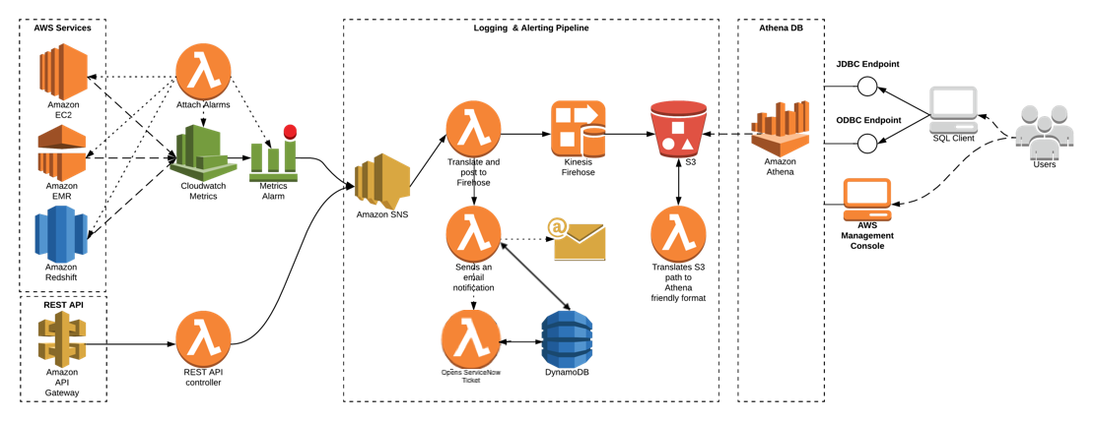
Cloud Monitoring Infrastructure and Custom Application
Logging & Alerting Pipeline
Provisioned dataset
Extending L&A Pipeline for Custom Alerts and Service Now Integration

Slide 21
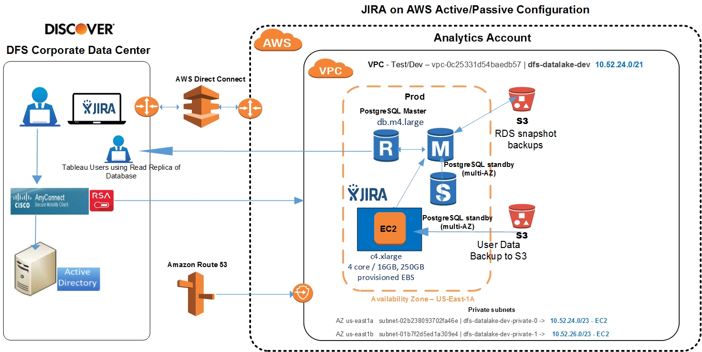
JIRA on AWS for Enterprise Use
JIRA on AWS Active/Passive Configuration

Slide 22
CLOUD DATA PRODUCTS
UNIVERSAL DATA LOADER
CLOUD DATA PATTERNS
OWNER : BRENT DEMAR
WILLIAM CLEMENS

Slide 23

DRAFT
Data movement patterns
6
On-premise ETL
Future Cloud-native ETL
(Abinitio containers)
RDS / PCF Data sources
(Acquisition)
AbInitio
ETL grid
Datahub
Future state
8
Universal Data Loader
External data sources
Hadoop
1
2
3
Enterprise
S3 Data Lake (AVRO)
Snowflake
Streaming data sources
Cloud ETL
(Spark)
API (Facebook, Google)
Kafka event bus
7
5
External data landing S3 bucket (Neustar)
4
Patterns | Timeframe | Description | Status
 | Oct ‘19 | On-prem ETL to S3 batch pattern – Backfills & Ongoing | Complete
 | Dec ‘19 | S3 to Snowflake load patterns – Backfills & Ongoing | On track
 | Dec ‘19 | Hadoop / ORC to S3 using Spark on Cloud | Complete
 | Dec ‘19 | Facebook API to S3 | Complete
Patterns | Timeframe | Description | Status
 | Dec ’19 | Neustar data (ORC format) to S3 | Complete
 | Jan ‘19 | PCF / RDS data to S3 | On track
 | Mar ‘19 | Real-time data from Kafka to S3 | Not started
 | Q4’19 | Cloud-native AbInitio ETL platform and Raw to Curated transformations on AWS | Not started
1
5
2
6
3
7
4
8

Slide 24
Universal Data loader: Multi-source to target , ‘Data as service’ integration
DRAFT
Data sources
Target
Universal Data Loader framework
Data load microservices
Teradata
Snowflake loader
Snowflake
EDS
Data Pre-load microservices
ORC
loader
ORC
Real-time events
Metadata Parser
Source-Target mapper
DDL generator
Operation metadata
Catalog loader
RDS
loader
AWS S3
(Avro format)
RDS
Hadoop
Graph
loader
External API
File ingestion Events
Graph DB
Unstructured data
Message Queue (Load events)

Slide 25

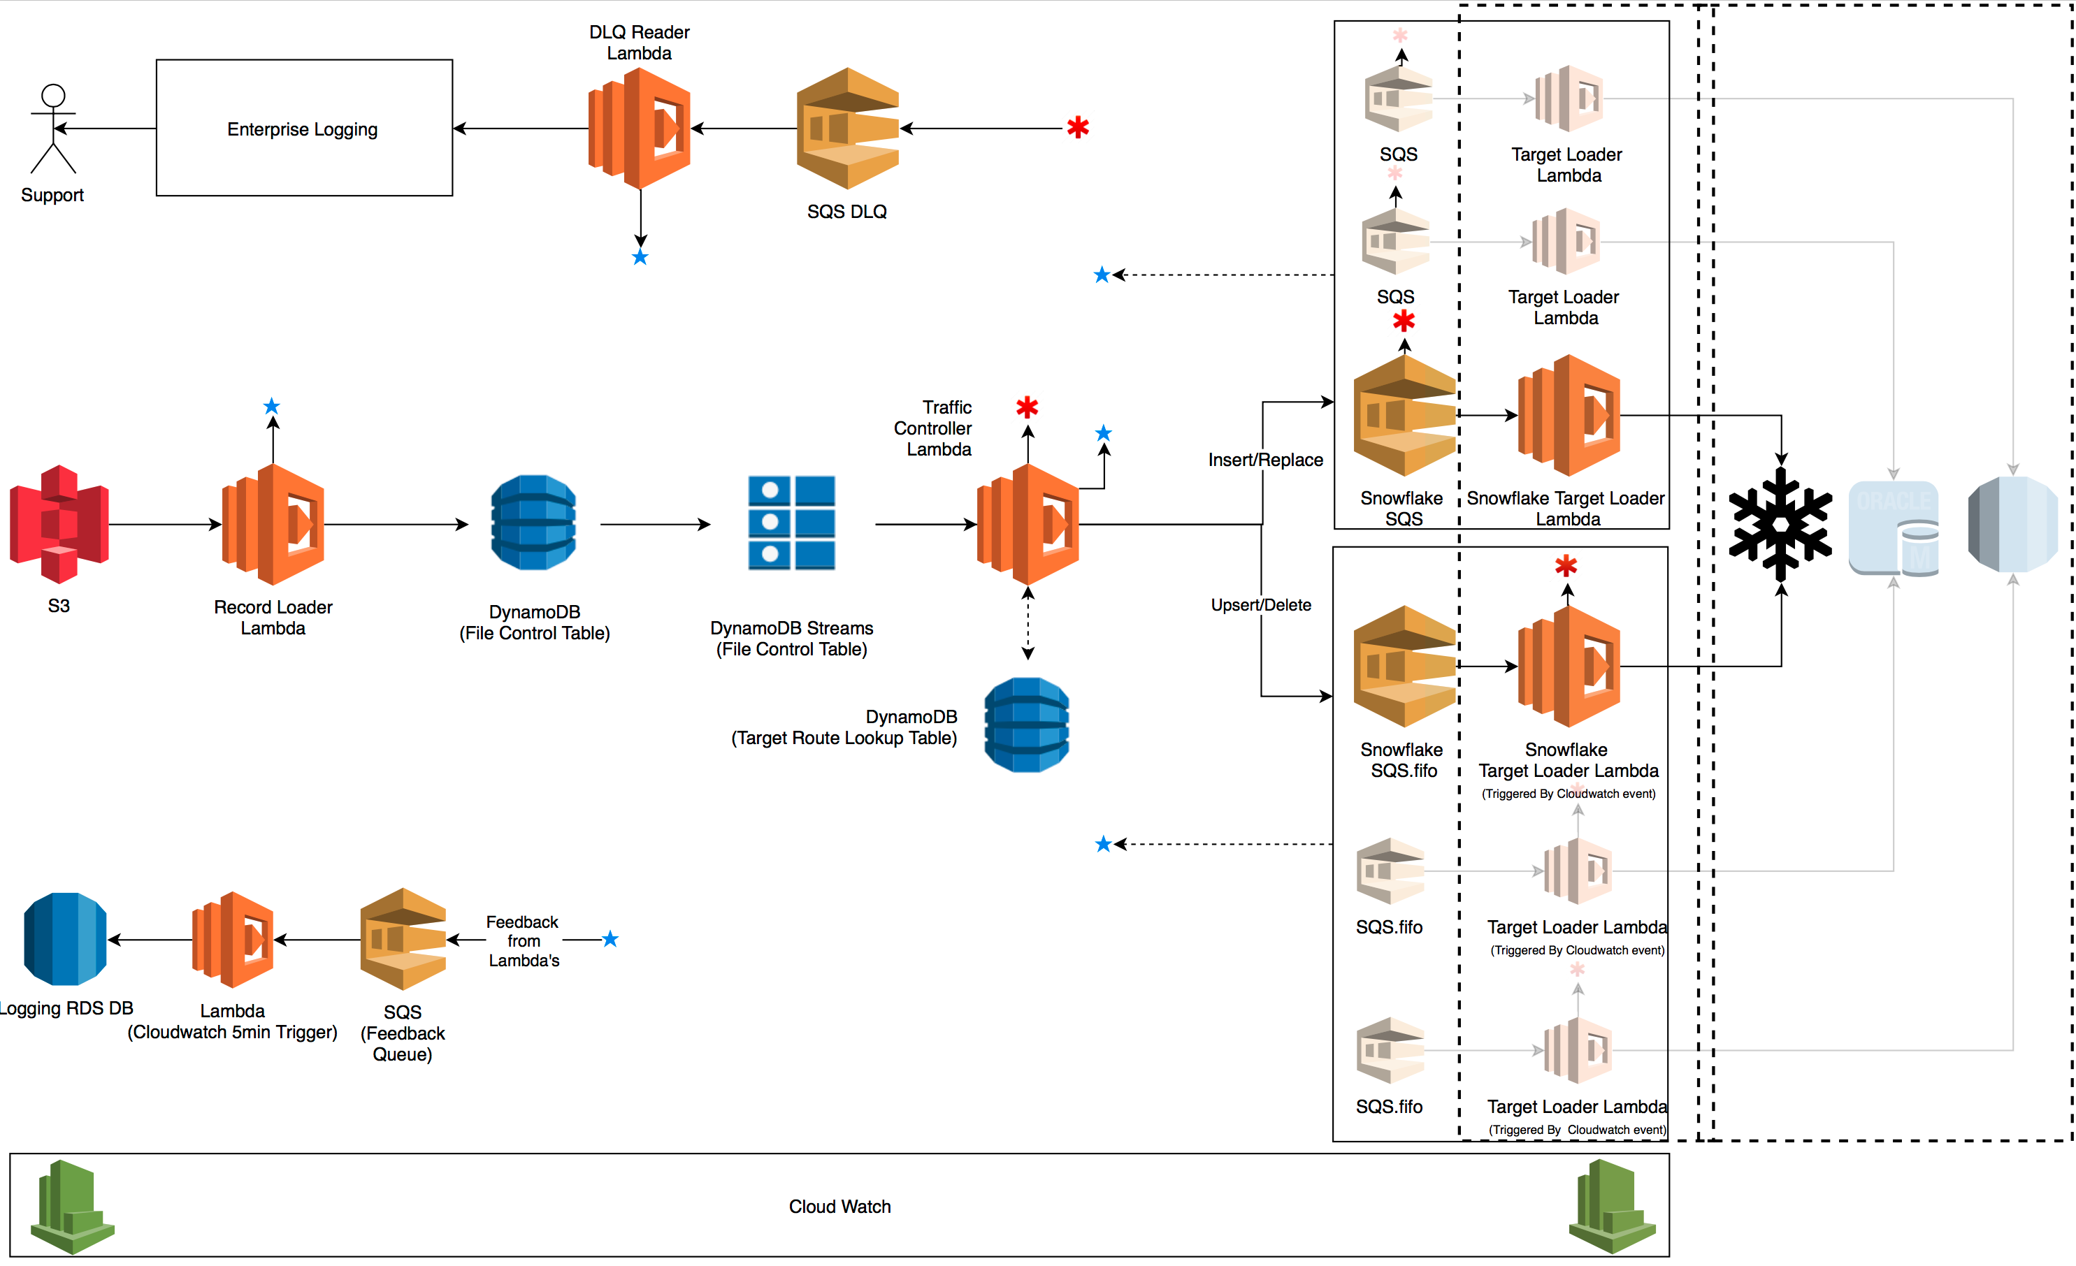
Universal Data Loader (Detailed architecture)
S3 - Location where the files will be landed. A S3 event will be configured which would trigger a call to the Record Loader Lambda function.
Record Loader Lambda - This lambda function is responsible for taking the S3 event and loading the message into DynamoDB
DynamoDB (File Control Table) - This is a DynamoDB table that will hold the information of all the files that land in S3
DynamoDB Streams (File Control Table) - This is a DynamoDB Stream that will maintain the order in which records get inserted into DynamoDB File Control table and pass those messages to the Traffic Controller Lambda Function.
Traffic Controller Lambda - This lambda function is responsible for reading messages of the stream and routing them to the appropriate path for the message/record/file to be processed.
DynamoDB (Target Route Lookup Table) - DynamoDB table used by the Traffic Controller Lambda function to instruct on which queues to route the message to.
SQS - SQS queue to hold the message to be processed asynchronously. Only for insert/replace file types.
Target Loader Lambda - This lambda function takes the message of the SQS queue and loads the file into the target system SQS.fifo - Fifo queue to hold the messages to be processed synchronously. Only for upsert/delete file types.
Target Loader Lambda (Triggered By Cloudwatch event) - This lambda function takes the message of the Fifo queue and loads the file into the target system. This Lambda will be triggered by a cloud watch event until AWS enables lambda trigger from fifo queues in the future.
SQS DLQ - SQS queue that will accept error messages. Lambda's will either send messages directly to it, or the asynchronous SQS queues will send messages there directly after certain number of retries.
DLQ Reader Lambda - This Lambda reads the DLQ queue and send the message to SES or SNS (might not need this if SES or SNS can connect to the DLQ Queue directly.)
SQS (Feedback Queue) - This queue holds records from the different lambda functions in fifo order so they can be picked up and written to the RDS database for logging purposes.
Lambda (Cloudwatch 5min Trigger) - This lambda is triggered every 5 mins by a cloud watch event and picks up all the messages in the fifo queue and writes them to the Logging RDS DB.
Logging RDS DB - This database stores the logs of a file that gets processed and its status.

Slide 26
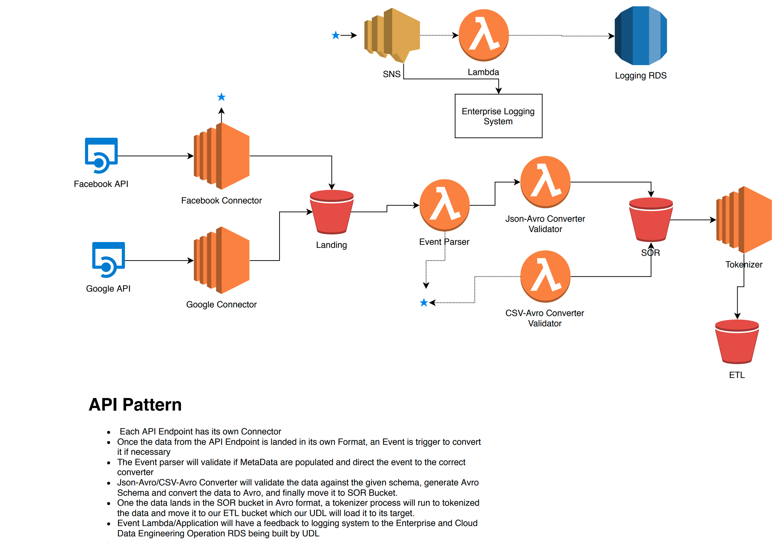
Data Products – API Ingestion Pattern

Slide 27
Data Products – Hadoop to AWS Pattern

Slide 28
Real-time data patterns
Real-time consumers
Stream processing
(FICO-S)
Event-processing & real-time rules engine
Cassandra event store
Near-real time analytics
ELK stack
Real-time dashboarding
Event publishers
KAFKA – Enterprise Event bus
(Shorter retention)
Real-time events
Kafka - Analytics
Longer retention
Data Lake
Snowflake
Offline Analytics

Slide 29
DATA PLATFORMS
UNIVERSAL ACCESS LAYER (UAL)
OWNER : SHANNON SCHULTZ
MATT LAMBERT

Slide 30
Universal Access Layer to enable least privileged access to Advanced Analytics Enterprise Assets
Requests
Stewardship
Automation
Identity
Initialize
Leverage Identity Manager for all user asset request approvals
Have appropriate stewards/SMEs responsible for approving and auditing all asset access
Create a UAL fabric for the automated provisioning and governing of user asset policies
Leverage enterprise credentials for authenticating to advanced analytics assets
Create a one button approach for creating a temporary credential session, when necessary

Slide 31
Universal Access Layer to build compliant Enterprise Assets
Data Security
Build assets that store and transmit data securely by encrypting data at rest and in transit
Network Security
Each asset will be configured to create an audit trail of user actions for compliance
Audit Trail
Each asset will be configured to create an audit trail of user interactions for compliance
Data Security

Slide 32
Universal Access Layer - Component Diagram

Slide 37
DATA PLATFORMS
SNOWFLAKE
OWNER : SHANNON SCHULTZ
MATT LAMBERT

Slide 38
SNOWFLAKE : A New Approach to Data Warehousing Snowflake is a cloud-based data warehouse with a modular architecture de-coupling compute and storage
 |  | Centralize |  | Cloud Agnostic |  | Dynamic |  | Analytics Ready
 |  | Single source of truth Data centralized on AWS S3 |  | Can be hosted on AWS, Azure, GCP (2019) |  | Storage and compute can be deployed/ scaled in minutes |  | ANSI SQL support Access to curated datasets High performance
Snowflake architecture
Model lifecycle – Future state
Metadata | Monitoring |  |  | Optimizer |  | Security |  |  | Administration
Virtual Warehouse (User Access)
Credit Risk |  | Bank |  |  | Payments |  |  | Marketing
Data Assets (Schema)
Customer |  | Bank |  |  | Merchant |  |  | Marketing
Card |  | Bank |  |  | Payments |  |  | Acquisition Lighthouse
Compute Environment (Data Loads)
 |  |  | Universal Data Loader
Model
Training
Model
UAT
Model
Deployment
Virtual Warehouse
(Analytics)
Virtual Warehouse
(UAT)
Virtual Warehouse
(Deployment)
Snowflake
Snowflake S3 data copy
Customer Data asset
Snowflake’s modular architecture and de-coupling Storage & Compute , allows us to integrate Analytics and Decisioning on the same data. This will allow us to significantly reduce the Model lifecycle (currently 50 – 100 weeks)
AWS S3 Data Lake

Slide 39
GEN I PLATFORMS
ABINITIO ETL PLATFORM
OWNER : TODD BRUNS
ANTHONY PIECZ

Slide 40
ETL platform (AbInitio) resiliency and re-architecture
DRAFT
Legend
End of life
Target state
Abinito on AIX (Current)
Abinito on Linux (Interim)
Abinito on Cloud-containers (End state)
Q2 2019
SSB
BDC
Q4 2020
Worker node (Linux containers)
Head node (AIX)
Head node (AIX)
Scheduler
(Maestro)
Scheduler
(Maestro)
Worker node
(Linux)
Worker node
(Linux)
1
Scheduler
(Maestro)
Scheduler
(Maestro)
3
Orchestrator
(Harmony)
Orchestrator
(Harmony)
Cloud Scheduler
Orchestrator
(OpenShift)
Code promo
(Live queue)
Code promo
(Live queue)
Orchestrator
(Maestro)
Orchestrator
(Maestro)
Code promo
(Live queue)
Code promo
(Live queue)
Data Hub replacement / integration with Cloud
Worker nodes (AIX)
W1
W2
W3
W4
Data Quality
(B&C)
Data Quality
(B&C)
Code promotion
(Jenkins)
Data Quality
(Abi DQE)
Q3 2019
2
Shared storage (GPFS)
Shared storage (NFS)
Shared storage (Gluster / EFS)
Phase | Timeframe | Description | Gaps addressed | Gaps outstanding
 | June 2019 | Migrate jobs from Abi AIX to Abi Linux | AIX HW / OS, Head node constraints, Data Hub – Cloud integration | Maestro, GPFS, Orchestration, promotion tools, DQ
 | Q3-2019 | Migrate GPFS storage to NFS | GPFS | Maestro, Orchestration, promotion tools, DQ
 | Q4-2019 | Cloud based ETL ecosystem – Abi on containers, New scheduler, code promotion tool | Scheduler, Orchestration, promotion tools, DQ tool | -
1
2
3

Slide 41
DECISION & DEPLOYMENT
ZIPLINE
OWNER : BRANDON HARRIS
TINTU PATHROSE

Slide 42
Data science – Analytic workbench with integrated governance
Model/ Analytic platform (Q1 ‘19)
Model Deployment & execution (Q3 ‘19)
Decision suite (TBD)
Zipline
FICO DMP
(Architecture - TBD)
Model as service API
Container platform (Analytics)
SAS
H2O
R
Container platform
(Model execution)
Model tracking
Python
Spark
Jupyter
Model code
Model
code
Model code
Model lifecycle management
Alation Data Catalog
Common data asset
CICD pipeline
Container platform
(Model UAT)
Snowflake
S3
Model code
Model
code
Model code
Provisioned dataset
Data provision
Container provision
Tool provision
Model design
Model
development
Model review
UAT
testing
Model
deployment
Model
execution
Model
performance
Model lifestyle
xxx
xxx
xxx
xxx
xxx
xxx
JIRA integrated governance and workflow (Q2 ‘19)

